Slide 1
OpenID Connect para Humanos
Lucas Espíndola

Slide 2



Slide 3




Slide 4
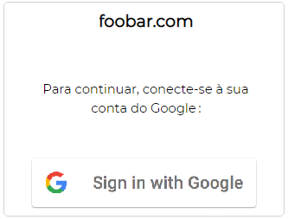
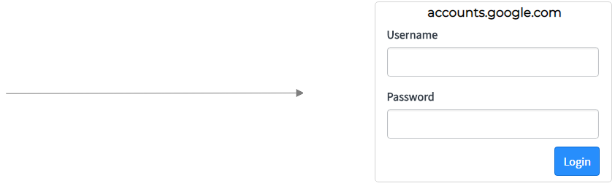
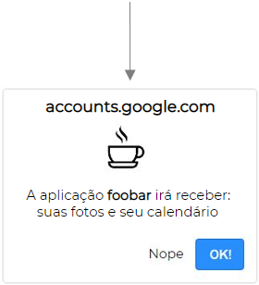

OAuth 2.0 code flow

Slide 5
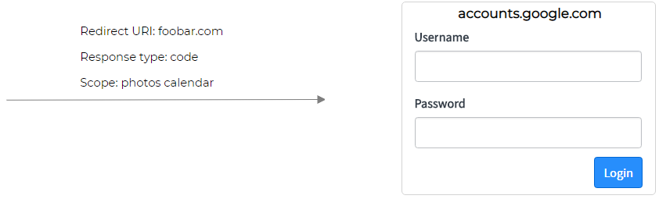
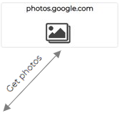
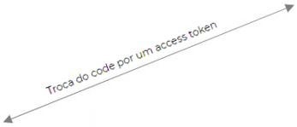
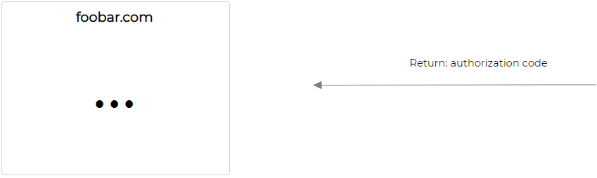

OAuth 2.0 code flow

Slide 6
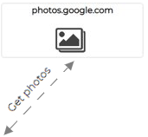
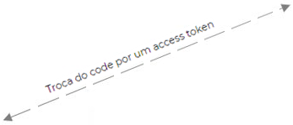
OAuth 2.0 code flow

Slide 7

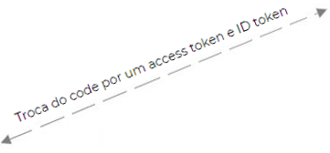
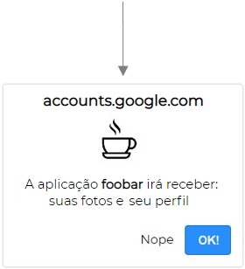

OpenID Connect code flow

Slide 8
OAuth 2.0 and OpenID Connect (in plain English):
https://www.youtube.com/watch?v=996OiexHze0
Slides: https://github.com/espindolaa/TDCslides
Site pessoal: https://espindolaa.github.io/personal
LinkedIn: https://www.linkedin.com/in/lucas-espindola/

